Slide 1

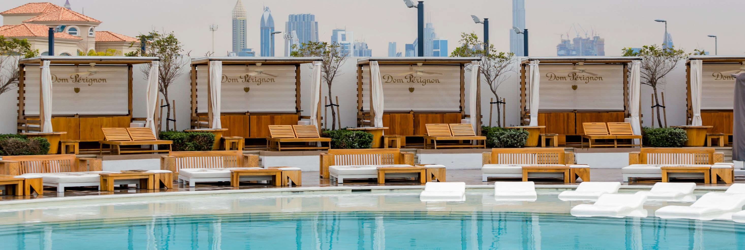
Bespoke Design & Fulfillment
Higney International, Hollywood, Florida 954-444-8754

Slide 2

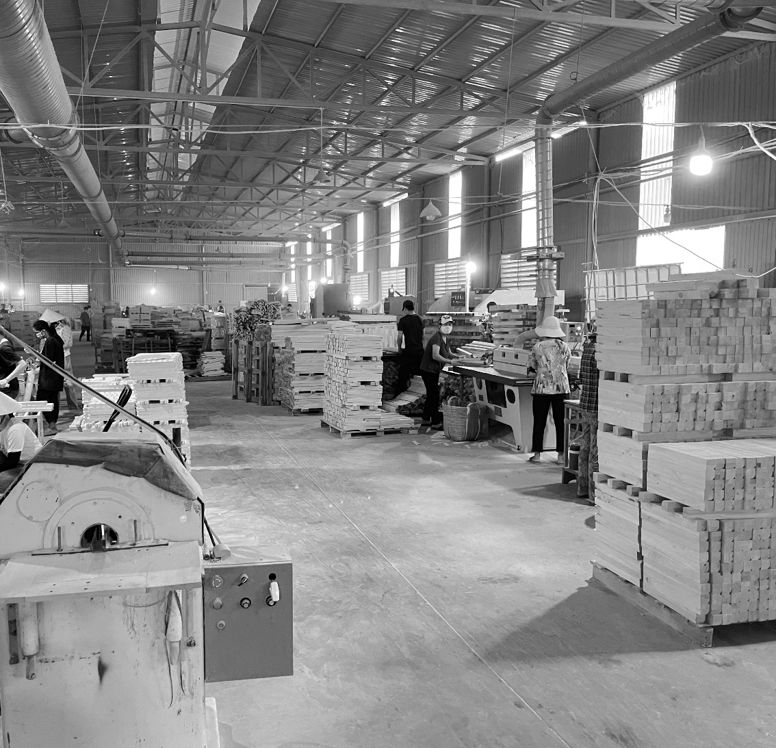
About
Welcome to Higney International, a premier design and fulfillment company nestled in the heart of South Florida. Higney International is operated by CEO Peter Higney, a former twenty-five-year veteran and VP of Hotel Development for Nikki Beach Hotels & Resorts. “Creating venues that evoke an emotional response through their aesthetics is what drives us in pursuit of perfection.”
As a premier hybrid design and furniture fulfillment company specializing in developing outdoor spaces for four- and five-star markets, we pride ourselves on bridging the gap between architects and clients to create spaces that are both aesthetically stunning and functionally efficient. From a project's inception, we work closely with both parties to understand their vision, preferences, and budgetary projections.
Our team of designers brings a wealth of expertise to the table, ensuring that every aspect of the design process is carefully curated to optimize both form and function. Whether it's crafting bespoke furniture pieces or conceptualizing entire spaces, our goal is to exceed expectations and transform visions into reality.
With Higney International, you can trust that your project is in capable hands, where creativity, craftsmanship, and client satisfaction are at the forefront of everything we do.

Slide 3







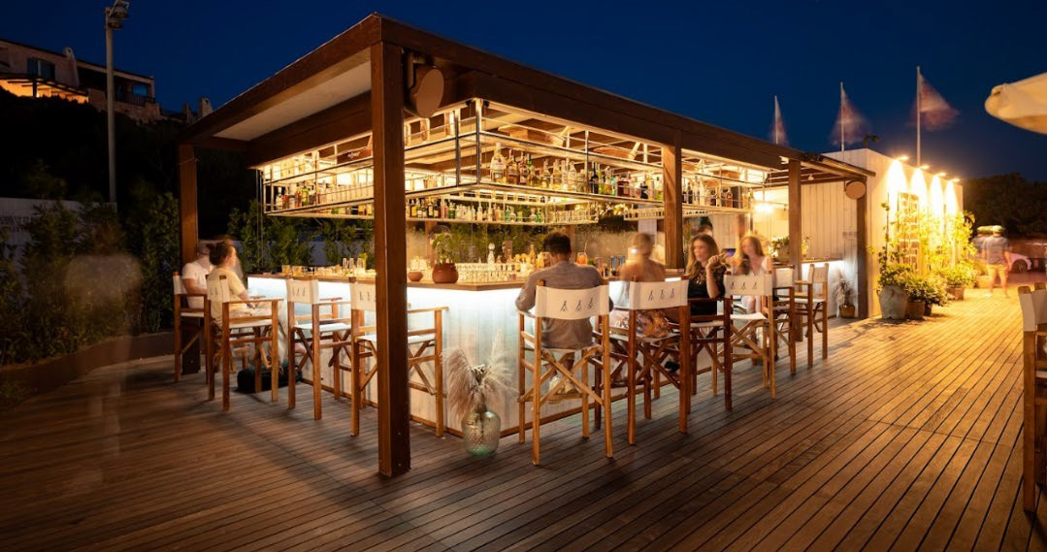






Clients
We understand that our clients' success lies in their brand's vision, and we are dedicated to amplifying that vision through exceptional design, planning and furniture solutions.
We believe that details matter and speak volumes about a brand's identity, and thus, we focus on delivering unparalleled quality, fit and exceptional durability.
Whether our clients are investing in capital expenditures or refurbishing their properties, we recognize that timing is critical, and that's where our expertise lies. We take pride in our ability to provide efficient and timely solutions, ensuring that our client's projects are completed smoothly and without delays.
TATE CAPITAL
Smeralda Holding

Slide 4















Trade Partners
With a global reach, we partner only with the best contract and custom manufacturers, driven by our commitment to eliminating risks and offering top-notch quality to our valued clients.

Slide 5
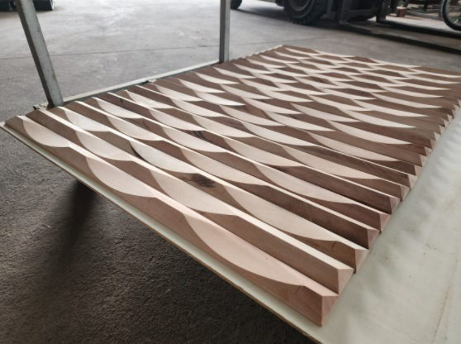
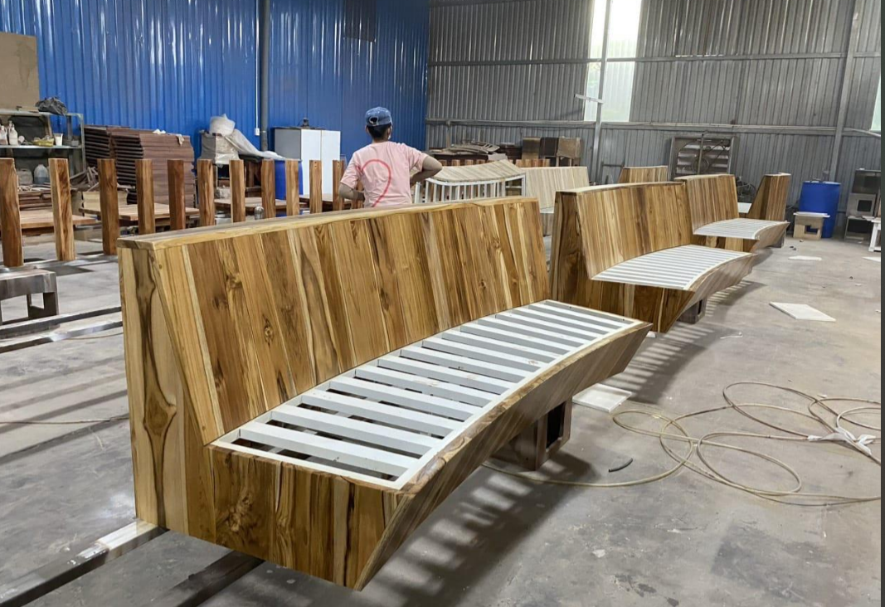
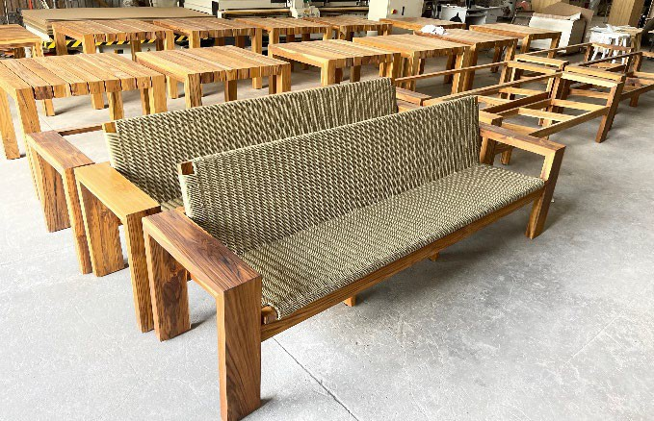
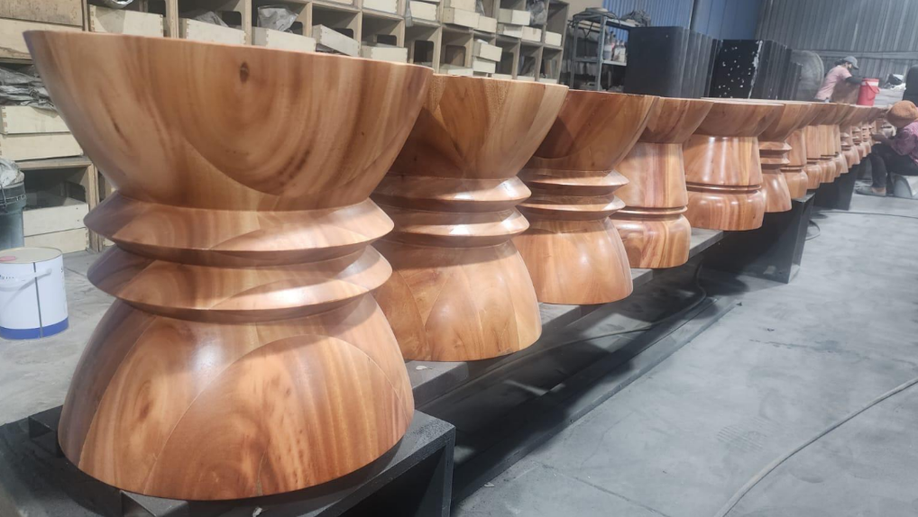
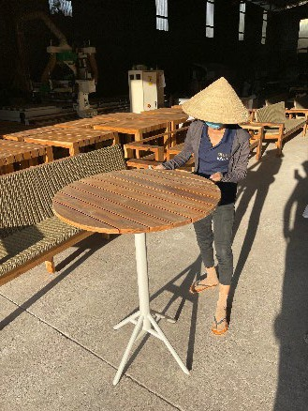
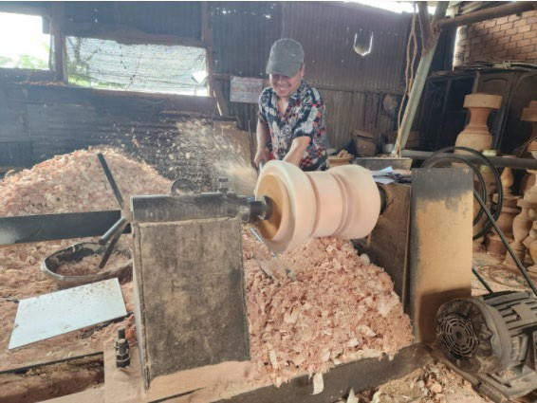
Custom Fabrication
More commonly, our clients seek a unique design not found on the market. The reason for this is the need to distinguish oneself in a marketplace where outdoor venues are traditionally clustered together.
Our team has the experience to transform owners’ concepts into a reality through the process of sampling and testing with certified partners to ensure product quality and durability.

Slide 6
Design

Slide 7
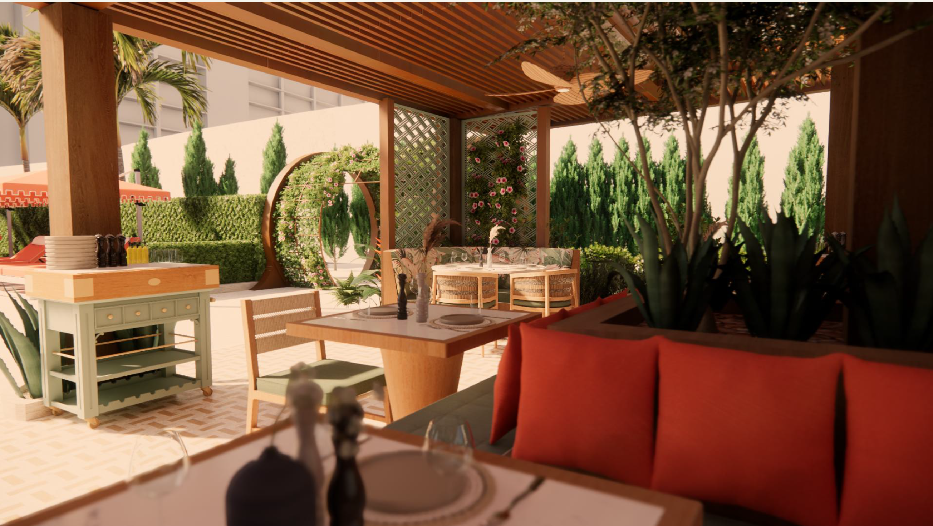
RITZ CARLTON BAL HARBOUR
CURRENT
The Ritz Carlton project is a complete retrofit of over 12,000 square feet of outdoor space and amenities, including the introduction of new F&B facilities, a pool, and VIP Cabanas. Estimated to reopen in 2026.

Slide 8
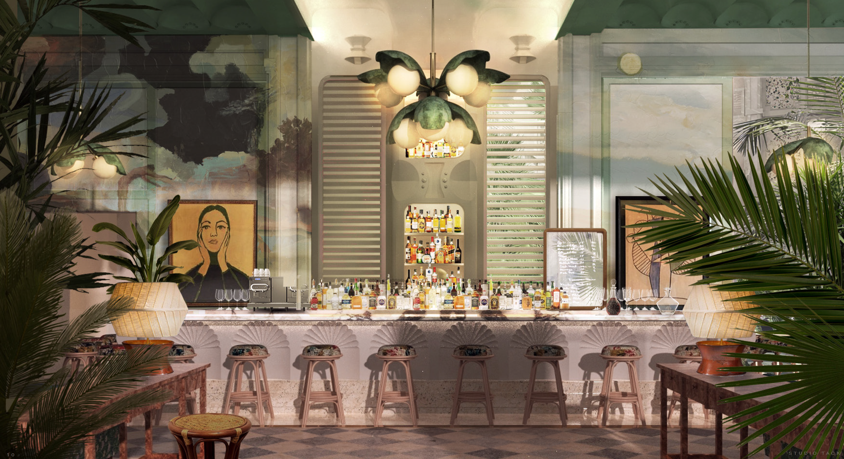
WINTER GARDEN HOTEL
CURRENT
A unique 66-room hotel development located Orlando Florida brought to Higney International by Knallhart Development Group. This unique project is modern design with a timeless twist. Set to open in 2028 .

Slide 9
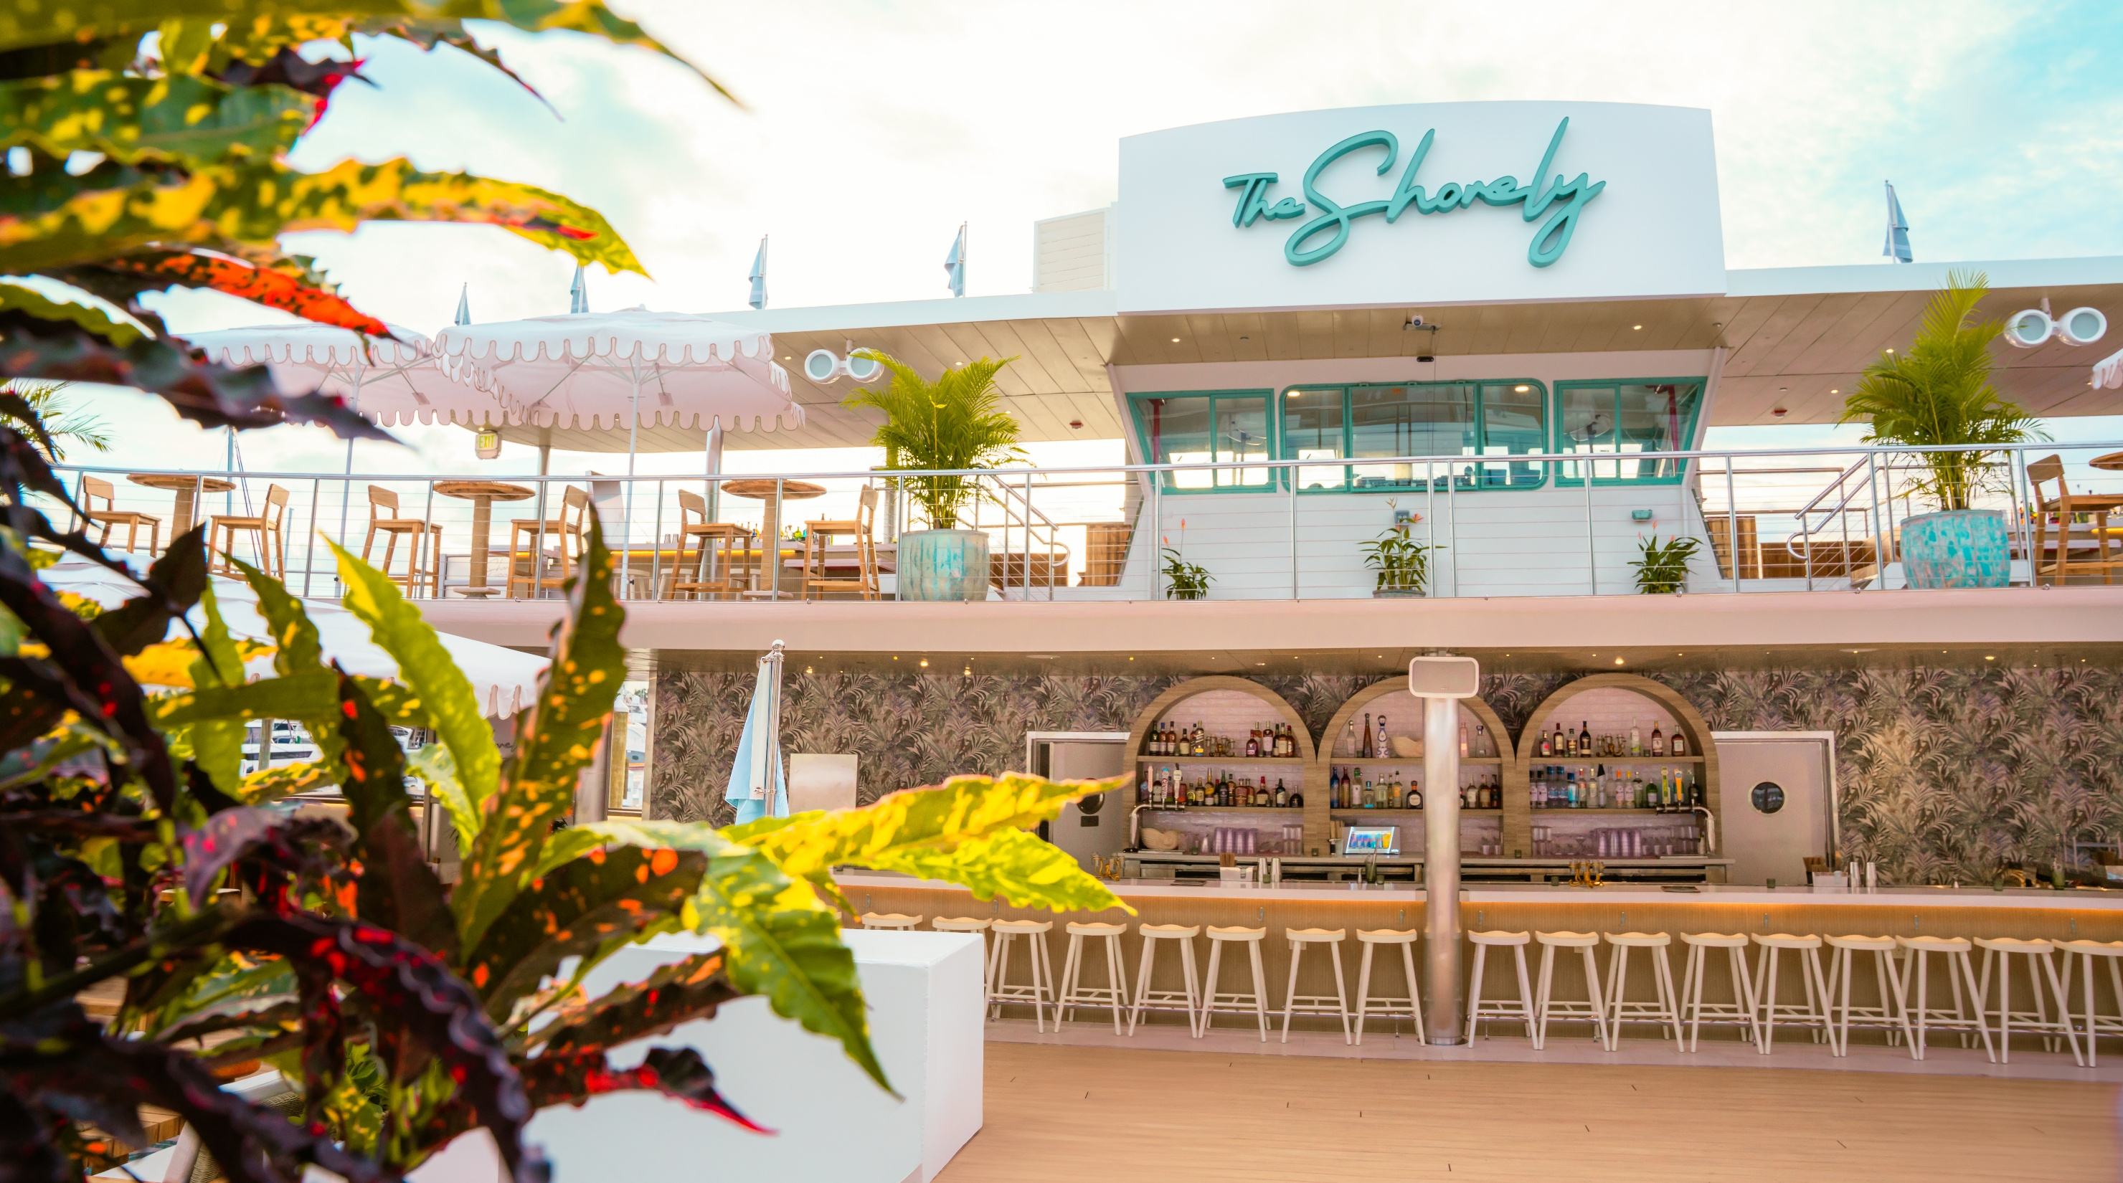
THE SHORELY CLUB FORT LAUDERDALE
COMPLETED PROJECT
The recently completed Shorely project of Fort Lauderdale was brought to Higney International by Tate Capital. The challenge was to design and develop a unique outdoor furniture offering that could withstand the elements, given its location and the limited storage space available.
Working directly with our clients and suppliers, we have produced durable and trend-forward design that adds to the aesthetic of the venue while maintaining our client's needs.

Slide 10
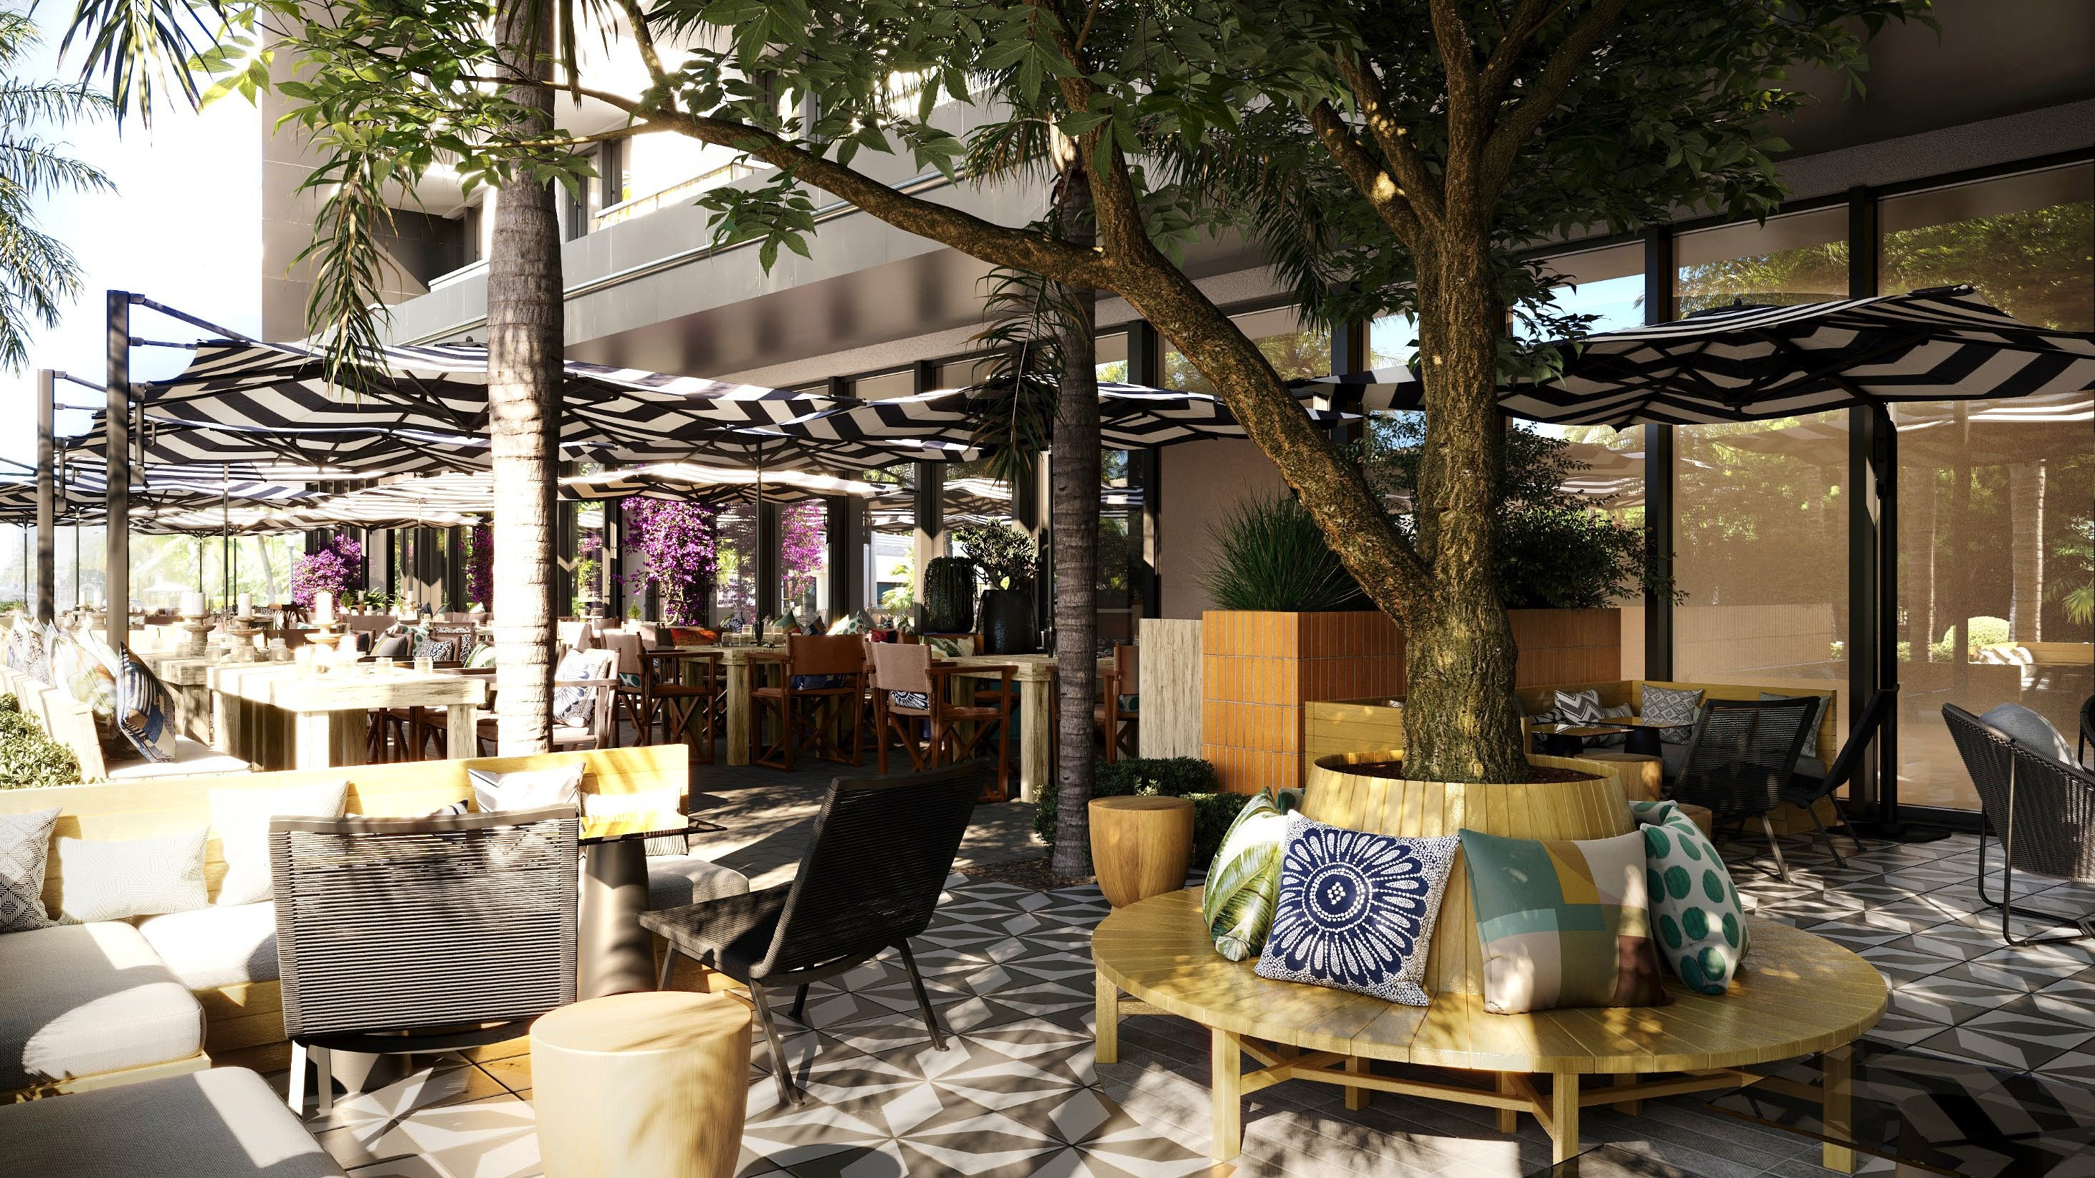
LA HABANA
(KIMPTON ANGLER’S HOTEL MIAMI)
Estimated opening: June 2025
Higney International is working with local Miami operator Georgios Vogiatzis, owner of Santorini by Georgios, to create a new concept for the Anglers Hotel in Miami.

Slide 11
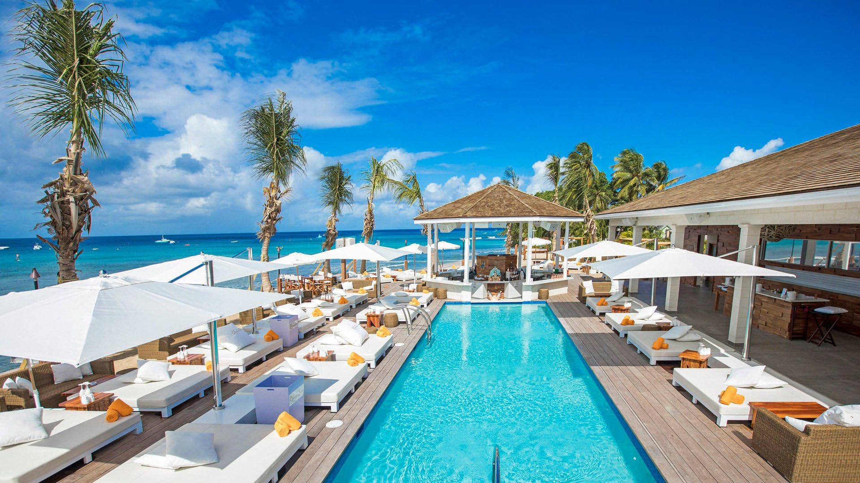
NIKKI BEACH BARBADOS
Project complete
Peter constructed this location as a new build on the North West coast of Barbados, in conjunction with Jada Construction, this facility marked the first luxury beach club on the island. Guest amenities include a swim-up octagon wet bar, oversized luxury pool beds and VIP cabanas.

Slide 12
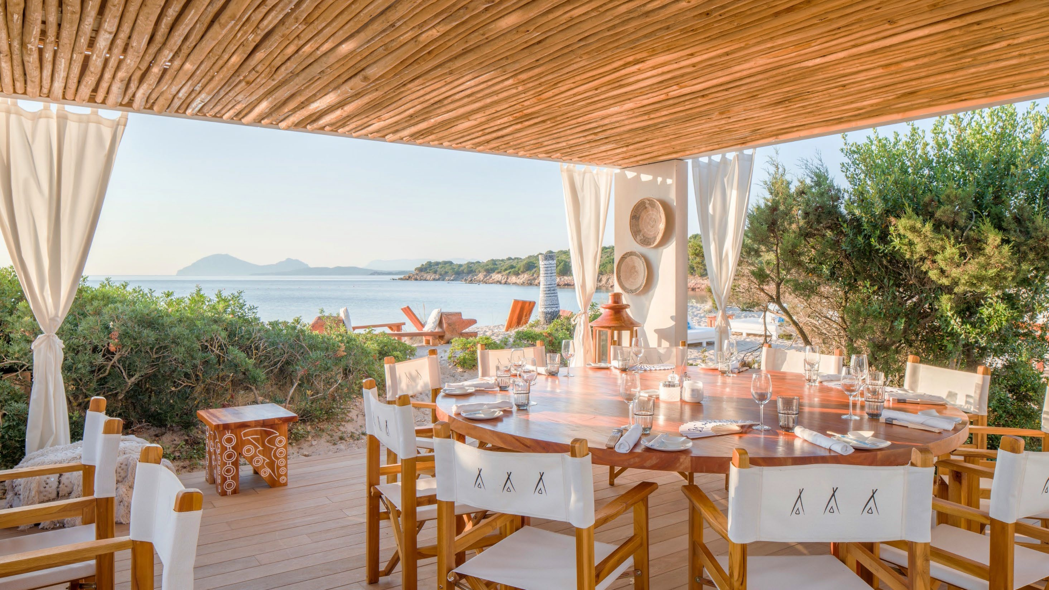
NIKKI BEACH COSTA SMERALDA
Project complete
Working with the Costa Smeralda group, Peter was commissioned to design and construct a unique beach club only accessible by boat for the uber elite demographic. This beach club was developed to be able to be erected and de-constructed annually after a 90-day operational period.

Slide 13
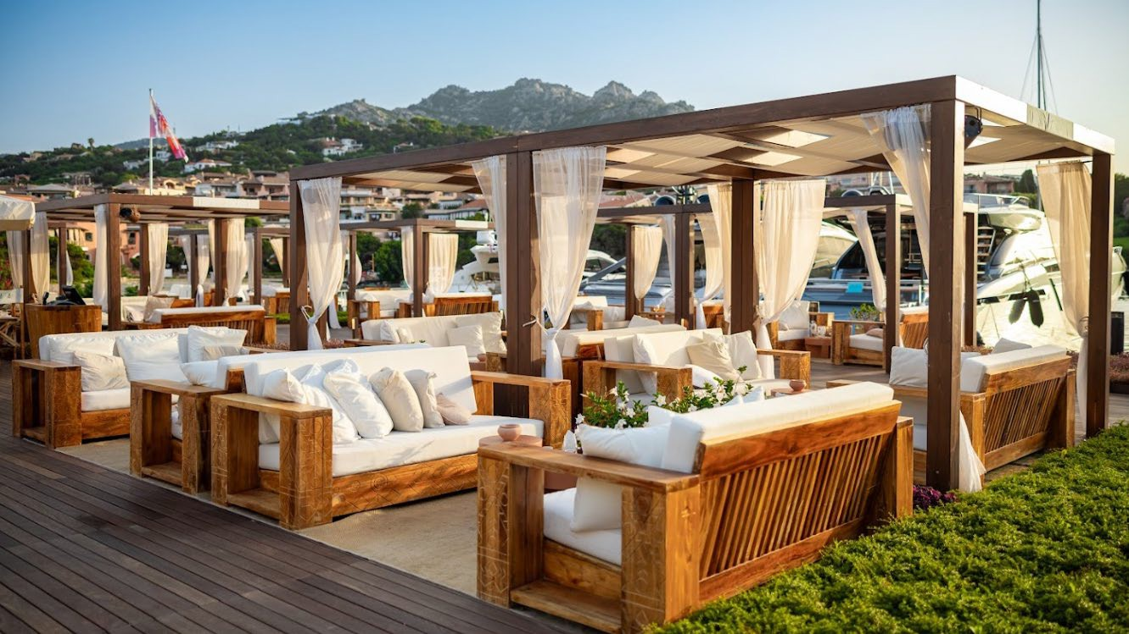
NIKKI BEACH PORTO CERVO
Project complete
Working with the Costa Smeralda group, Peter was commissioned to design a pop-up food & beverage outlet directly on the Marina front alongside notable luxury brands such as Ferrari, Maserati, Bugatti, & Breitling.

Slide 14
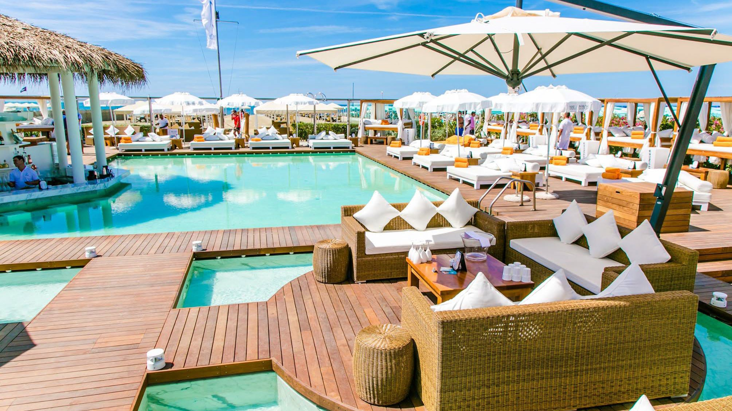
NIKKI BEACH VERSILIA
Project complete
Located on the white sands of Marina di Pietrasanta on the Mediterranean Sea, Nikki Beach, Versilia launched in an over-saturated market where distinction in design means everything. This luxury beach club and restaurant features a one-of-a-kind swimming pool fashioned entirely from Carrara marble, swim-up bar, octagon-shaped bar, plush sun beds around the pool and on the beach. Peter redesigned the operation in the second year in order to facilitate higher annual volume.

Slide 15
Fulfillment

Slide 16
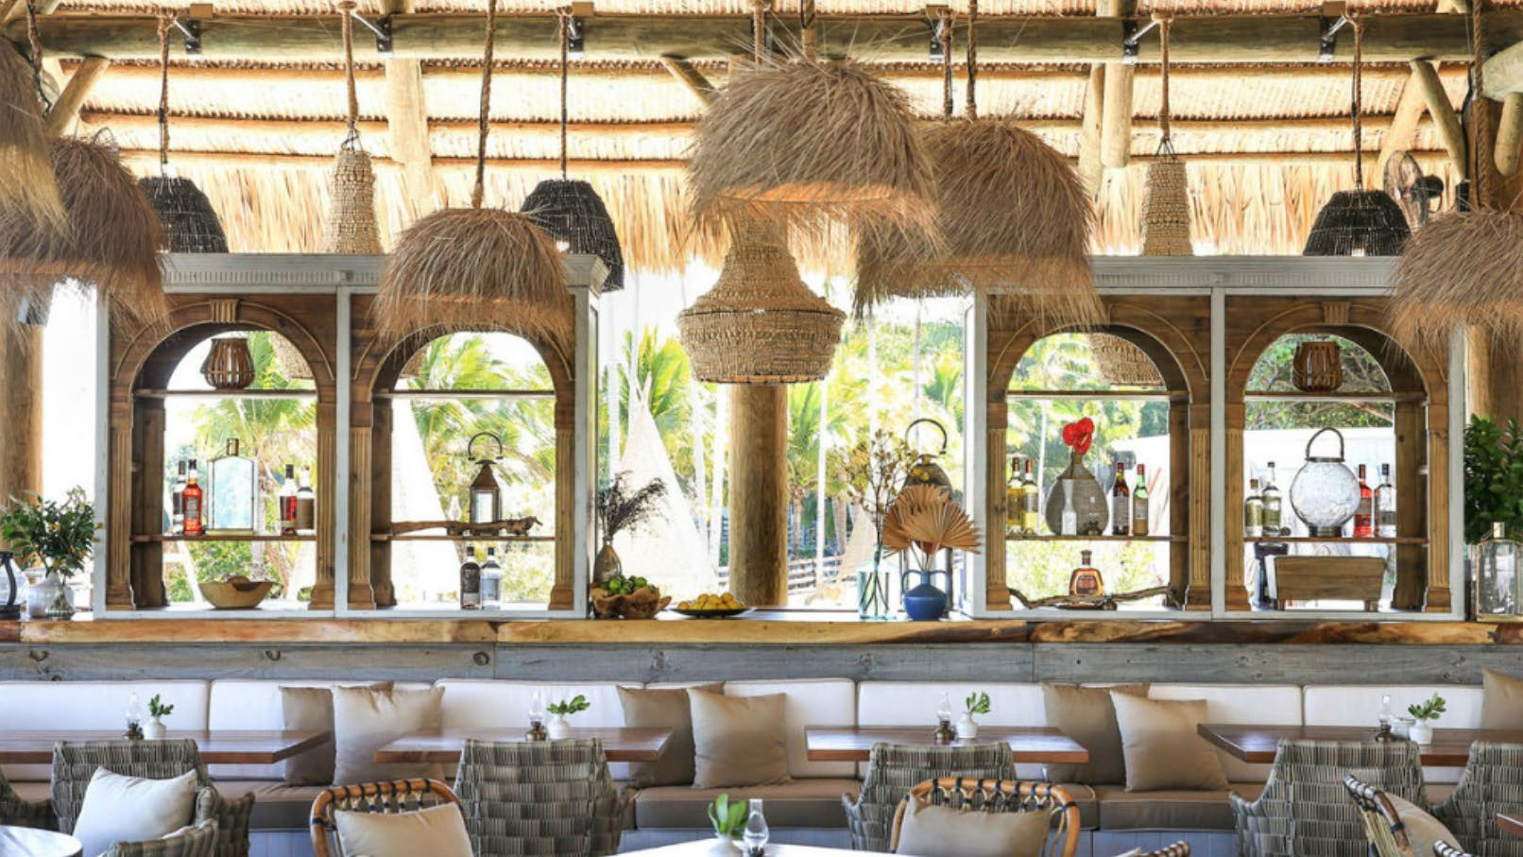
Joia Beach

Slide 17
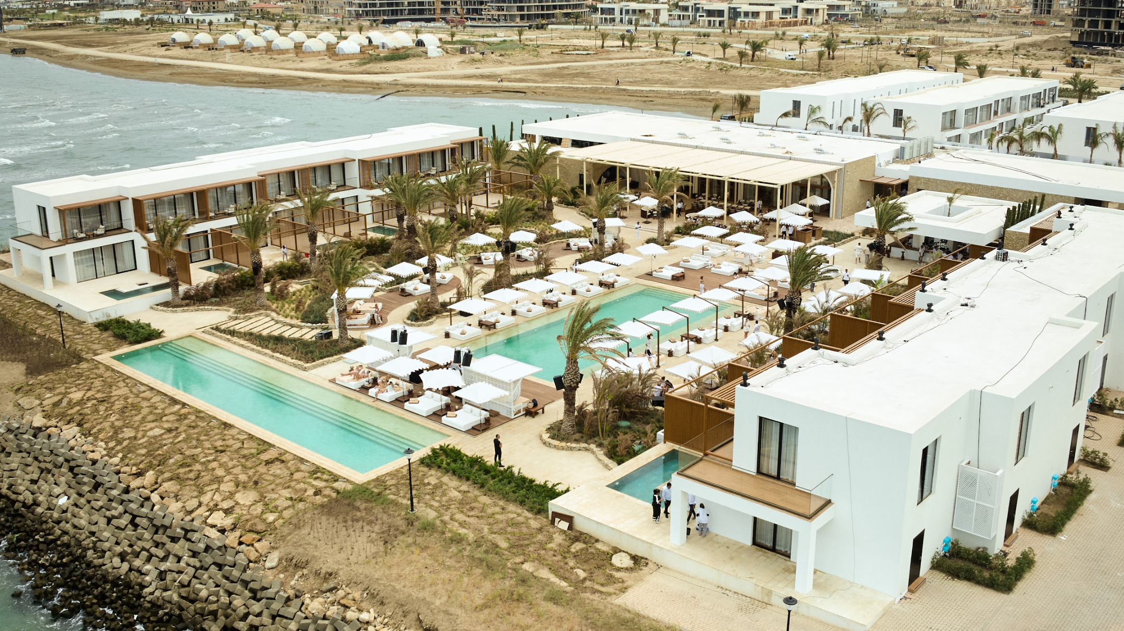
Nikki Beach Baku

Slide 18
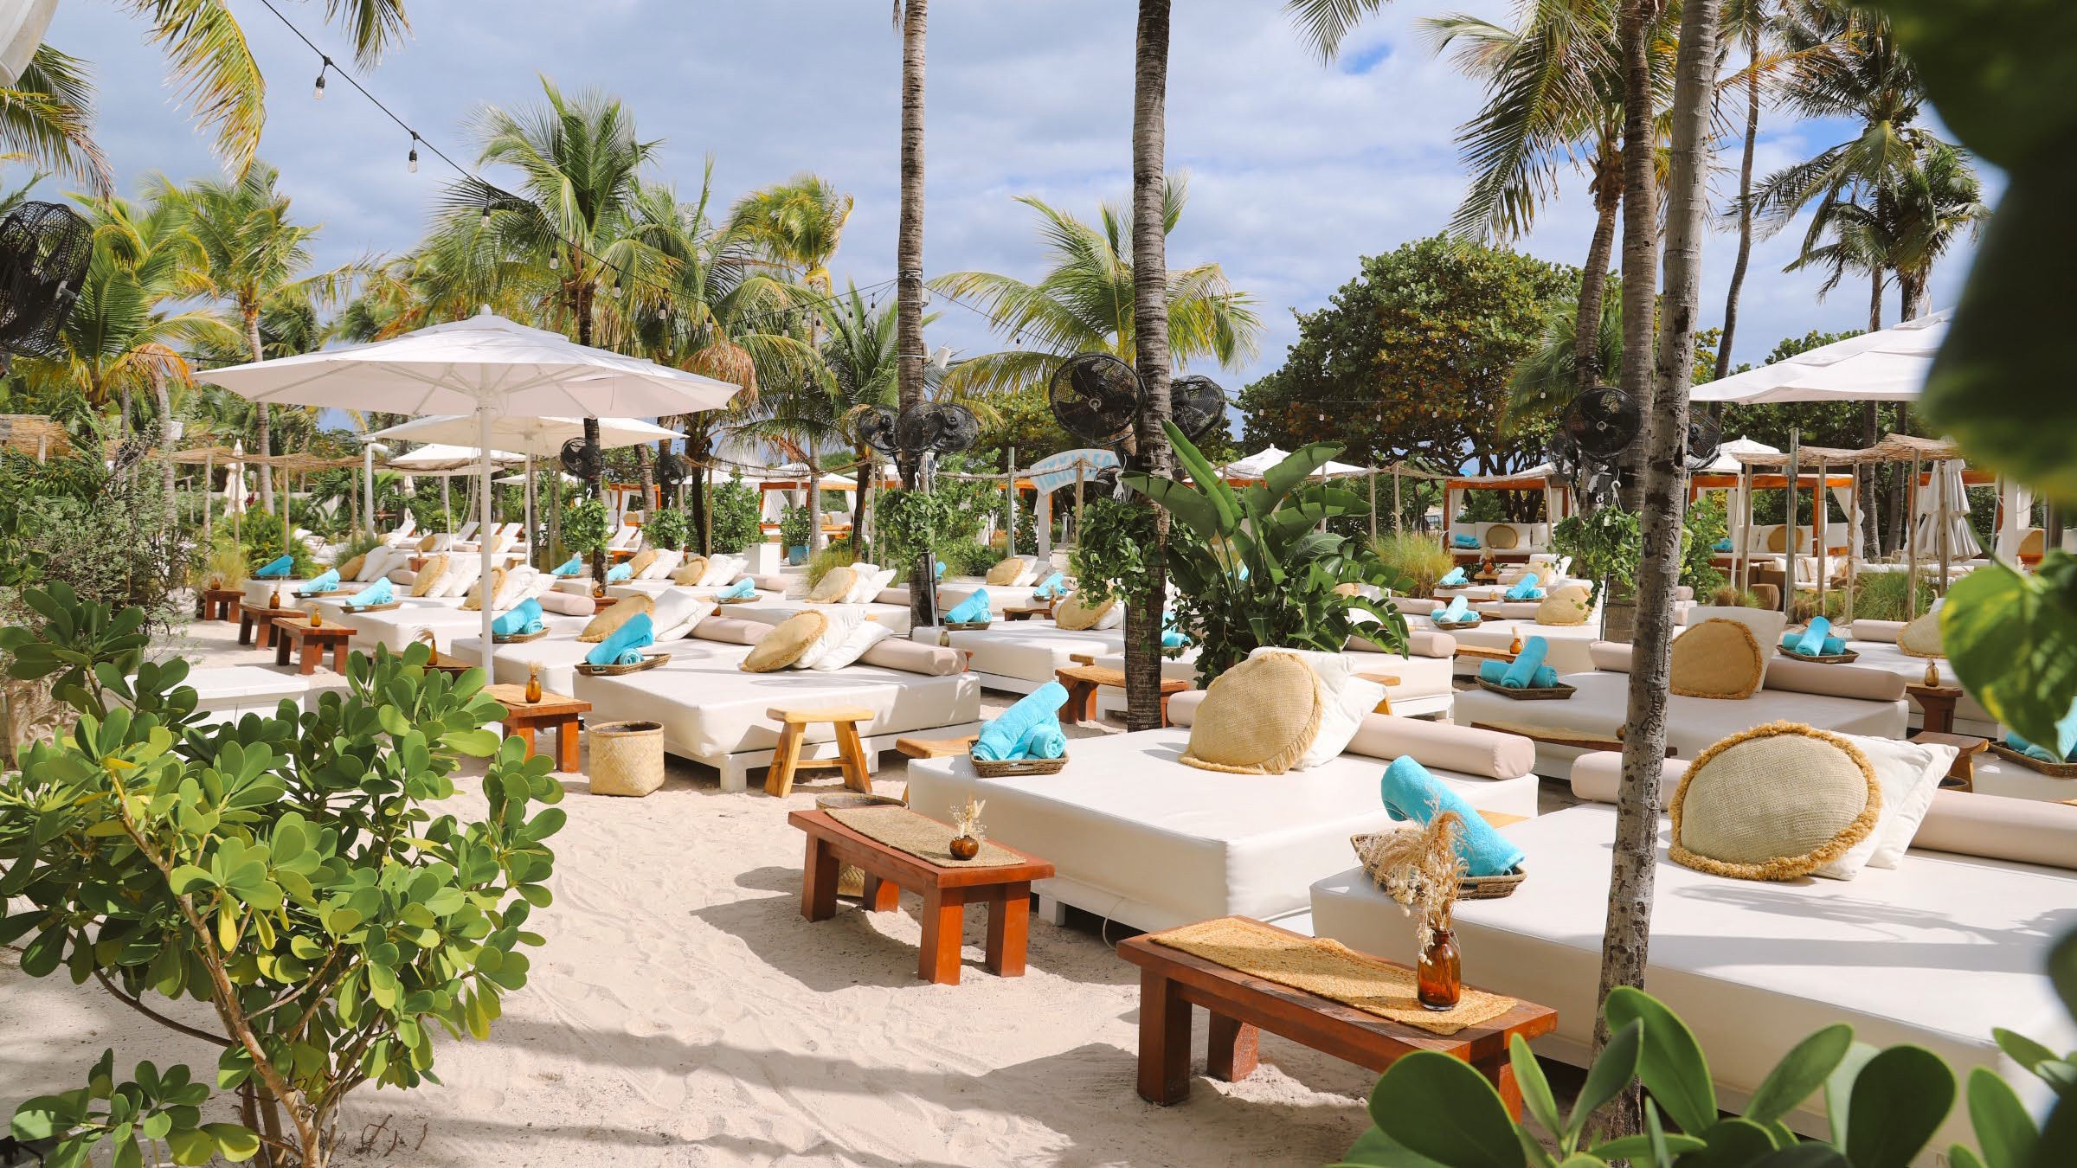
Nikki Beach Miami

Slide 19
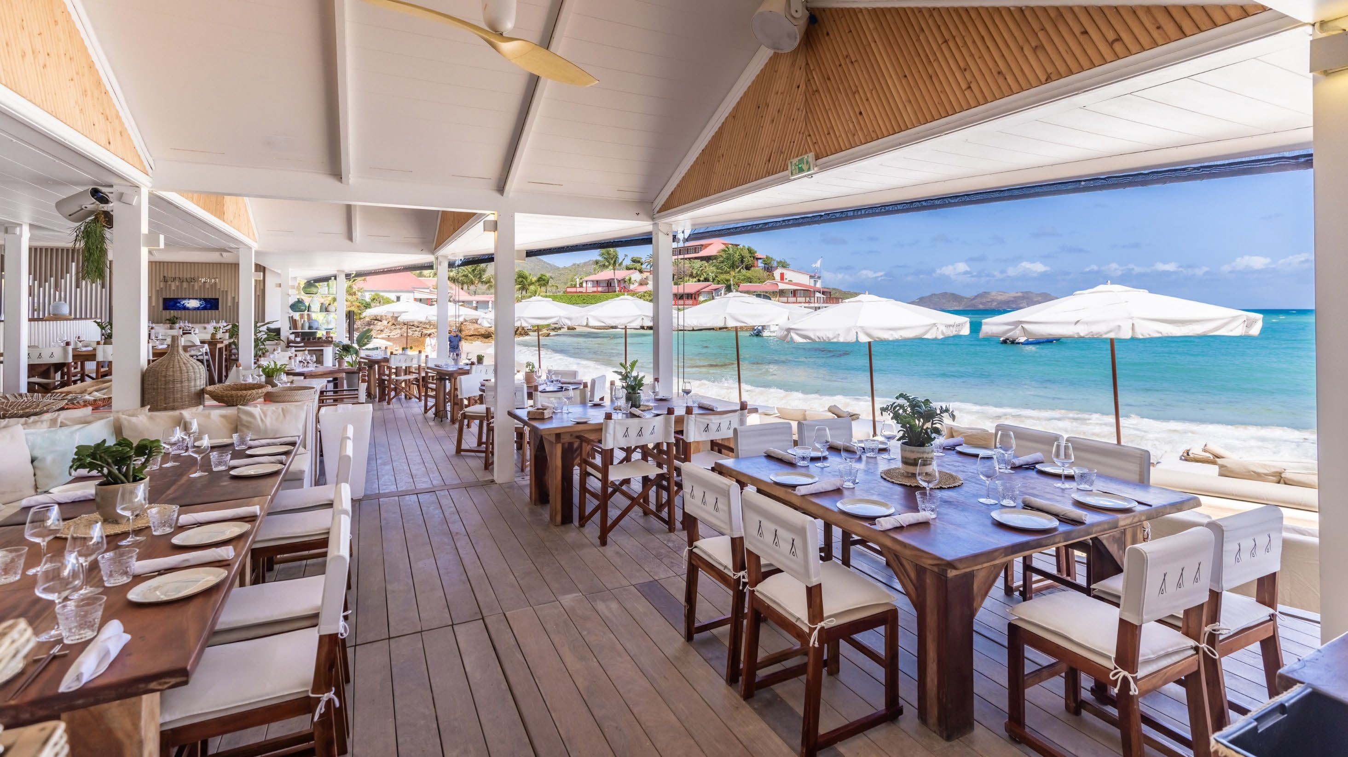
Nikki Beach St. Barth’s

Slide 20
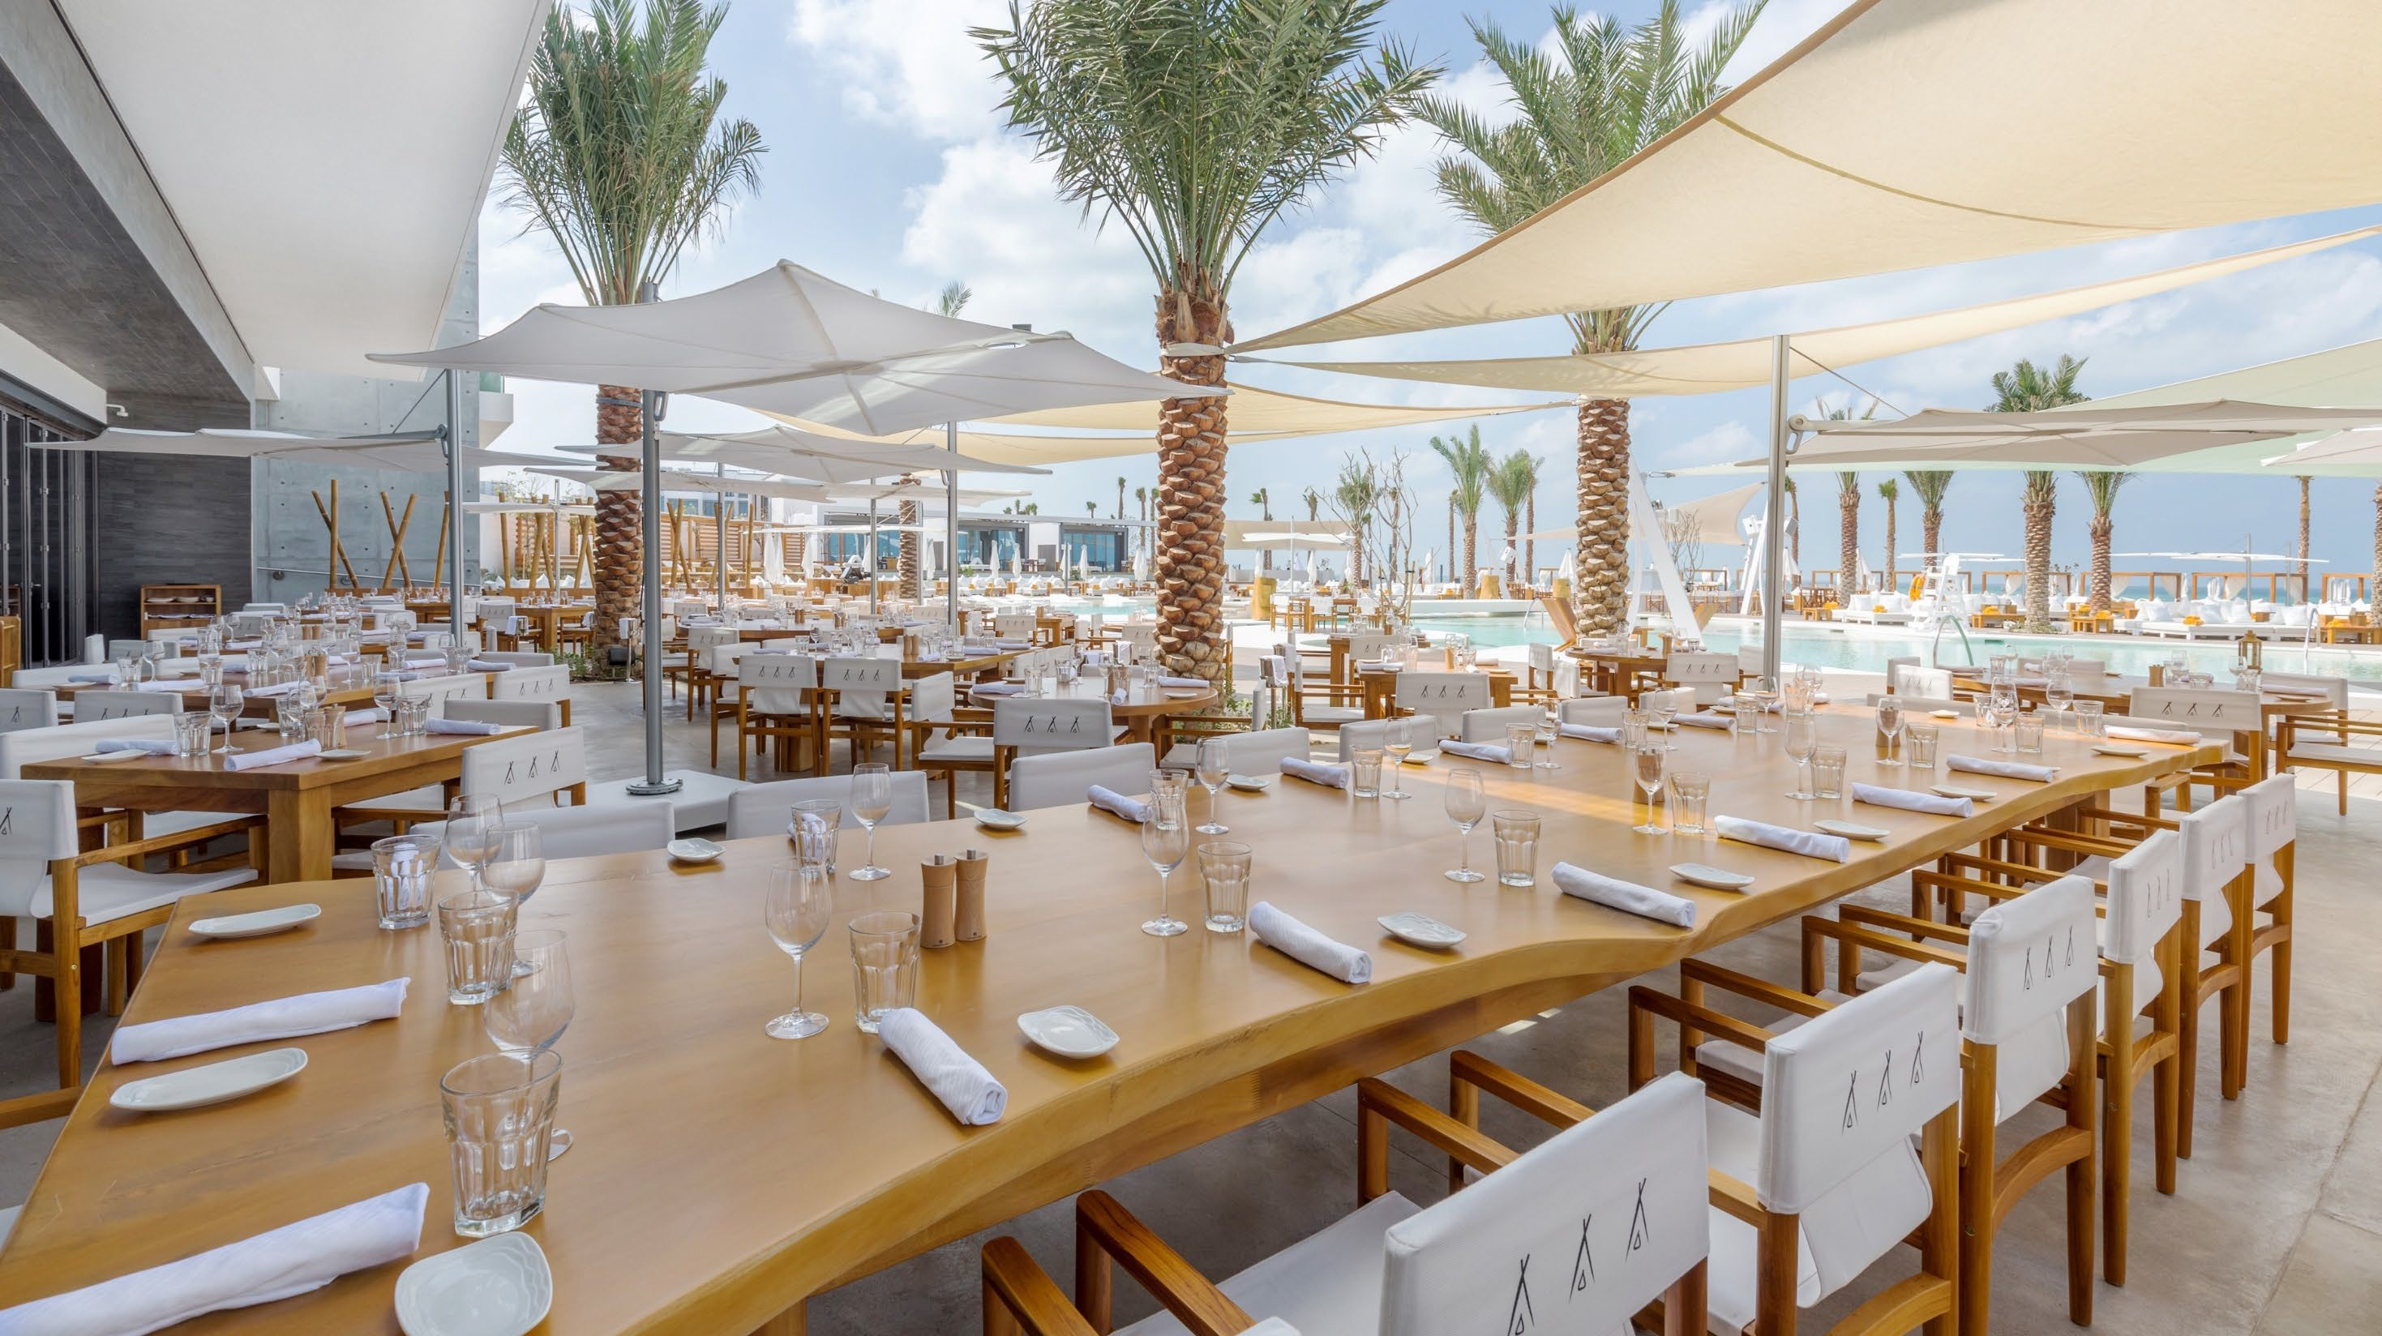
Nikki Beach Dubai

Slide 21
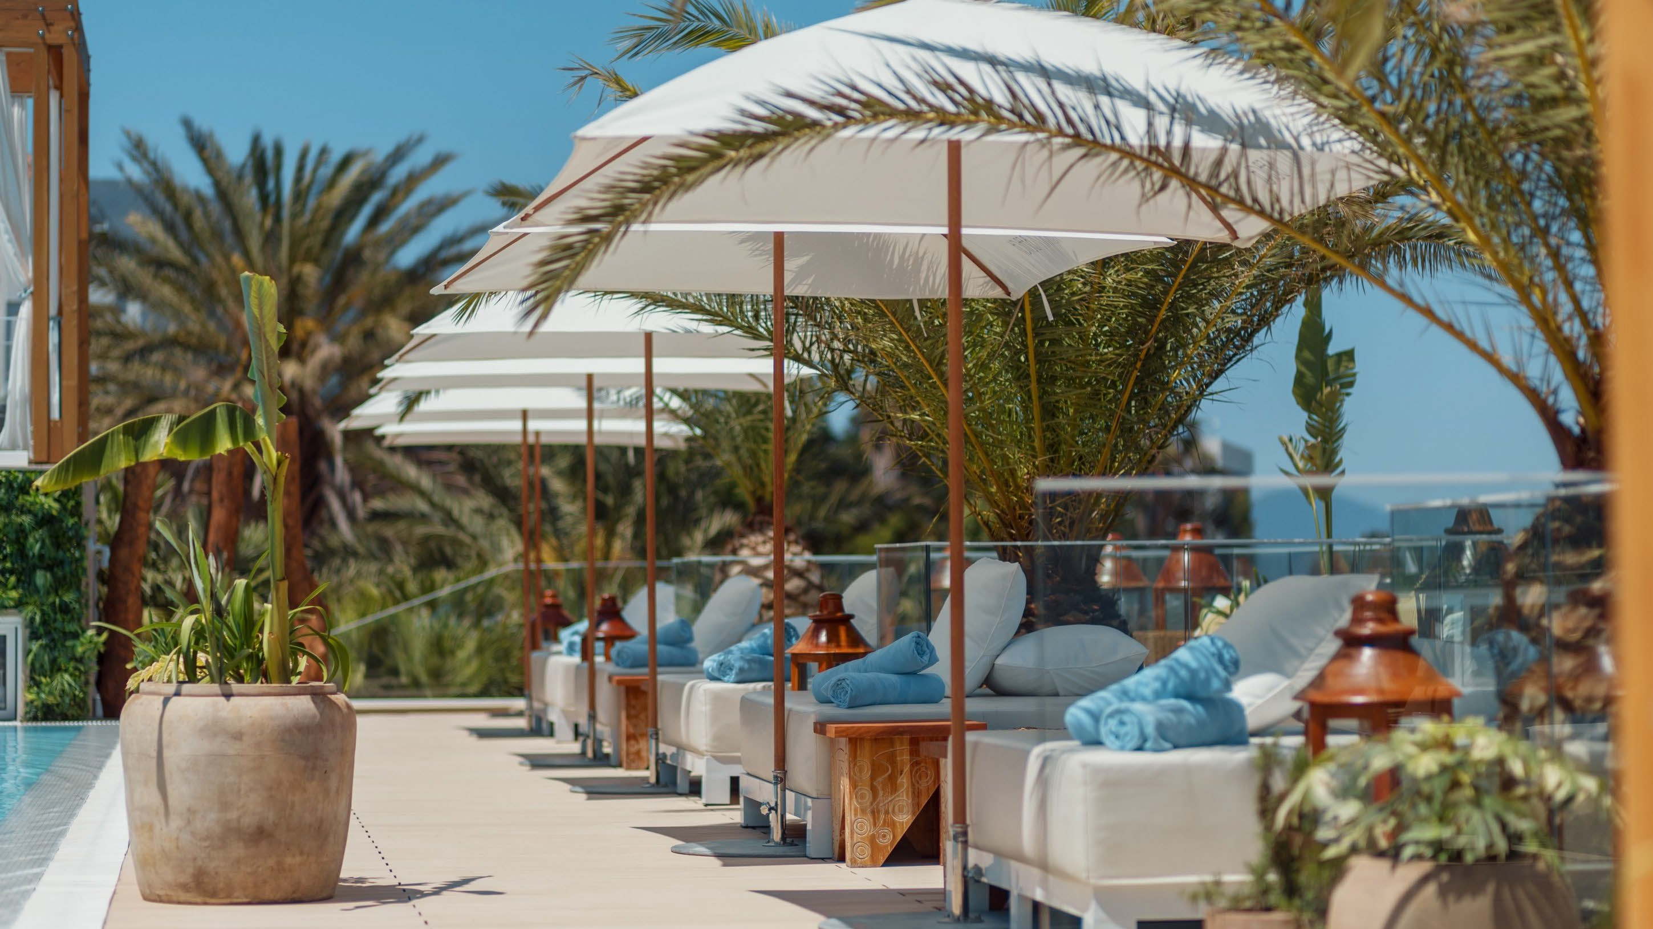
Nikki Beach Montenegro

Slide 22
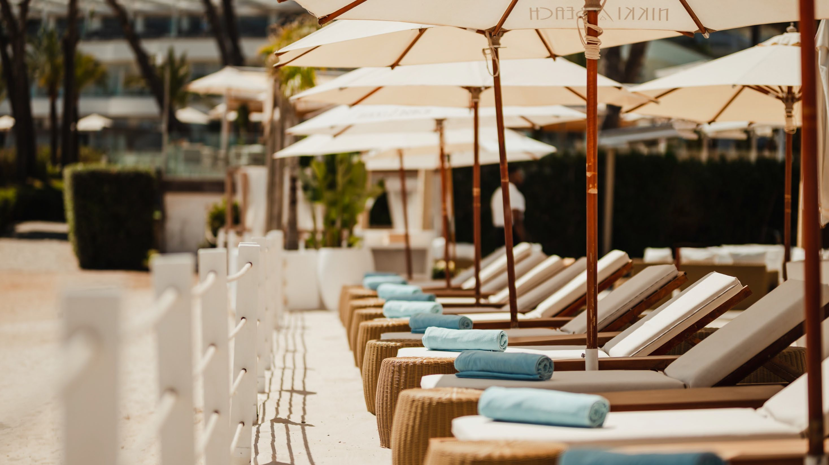
Jioa Beach
Nikki Beach Marbella

Slide 23
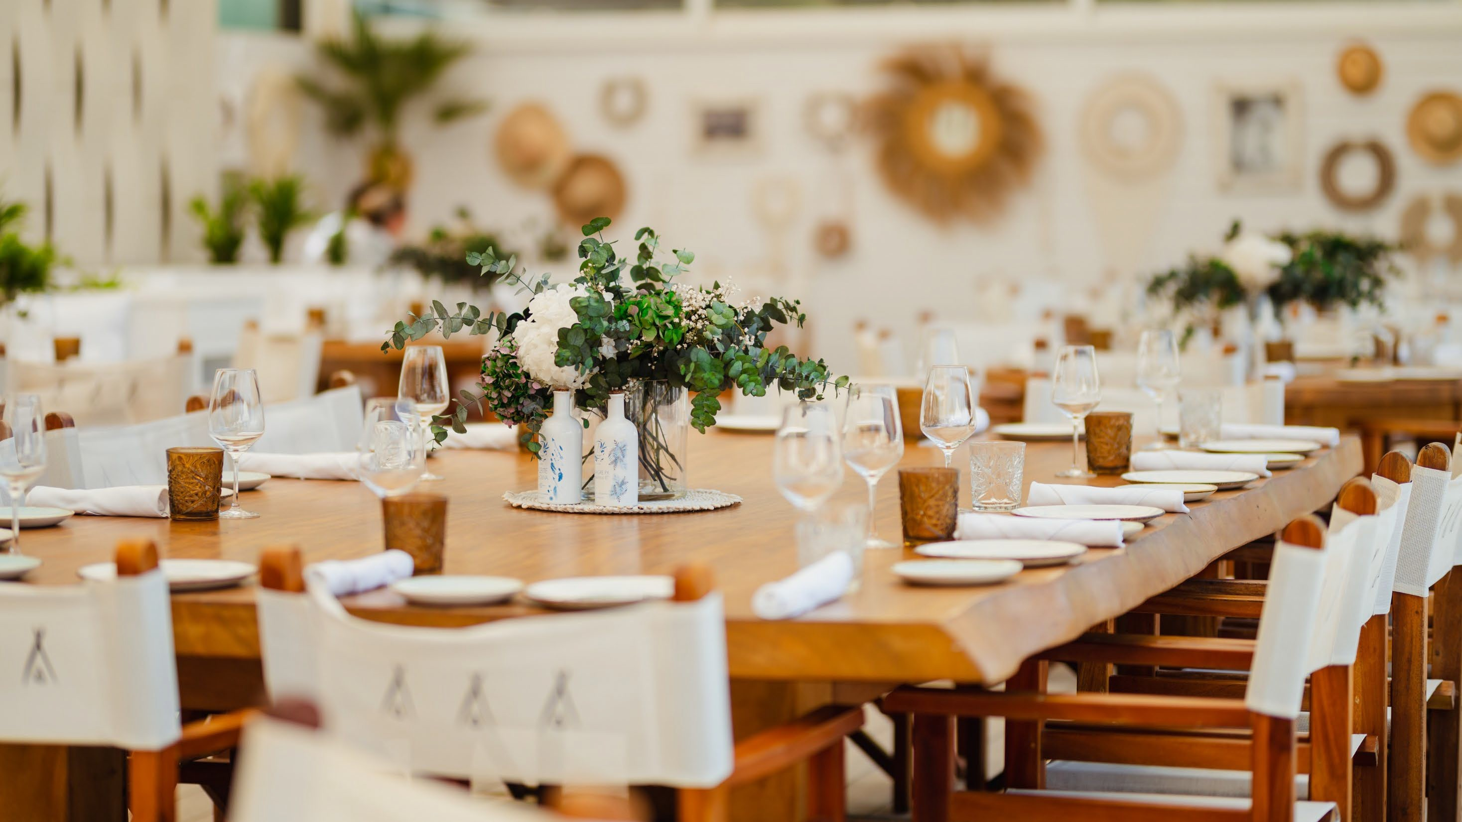
Nikki Beach Ibiza

Slide 24
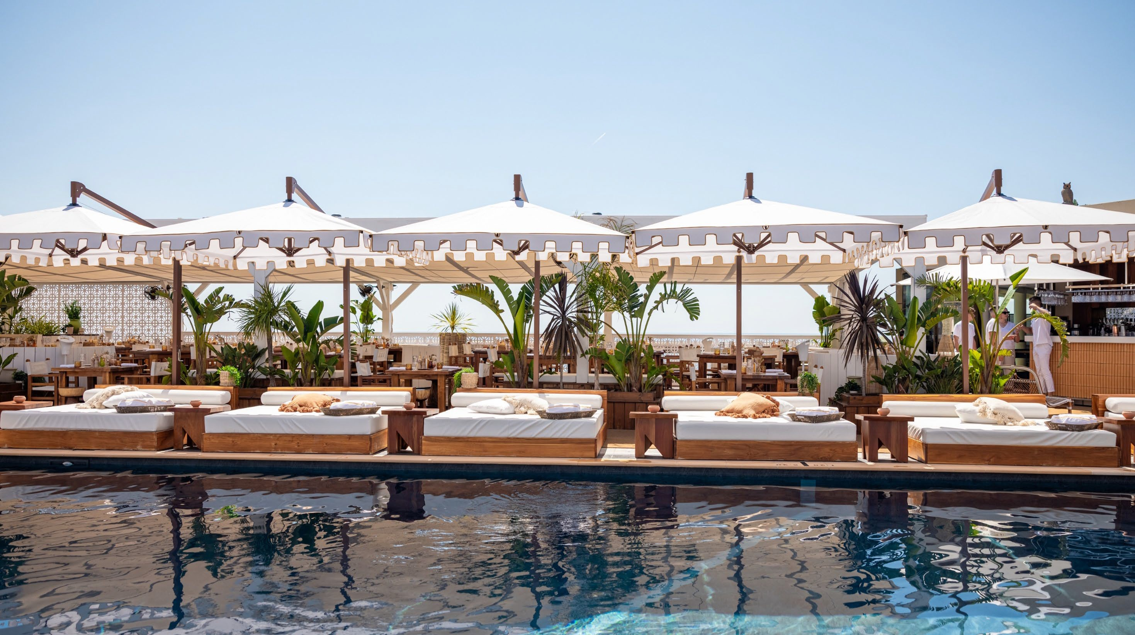
Shorely
Nikki Beach Monaco

Slide 25
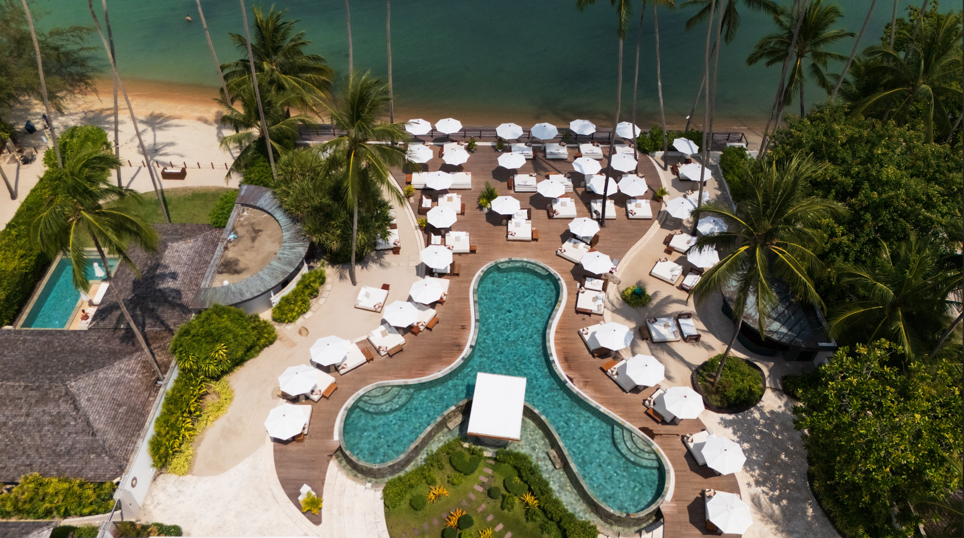
Nikki Beach Koh Samui

Slide 26
Thank You
Higney International
1720 Harrison Street
Hollywood FL 33020
E hello@higneyintl.com

